Slide 1
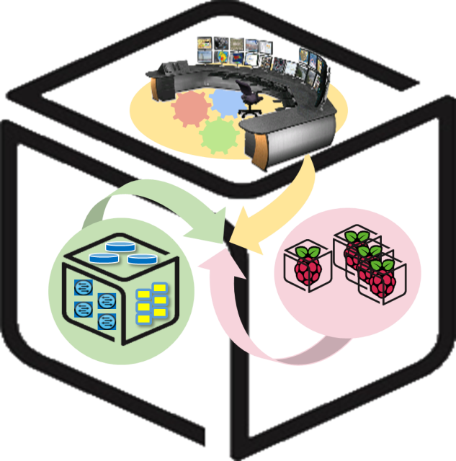



Computer Systems
For AI-inspired Cloud
Theory & Lab.
Lab #1: Box
https://github.com/SmartX-Labs/SmartX-Mini-MOOC

Slide 2






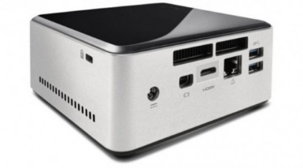
Box Lab: Outline
VM
Container
Tap1
ping test
br0
eno1

Slide 3


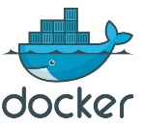

Box Lab: Final Goal
VM

Slide 4

Before you start
- Things you need to know
Lab Theory
Lab
Practice
Lectures are divided into Lab Theory, Lab Practice and Lab Review parts.
Lab
Review
The keyboard means that you should execute instructions by following the guidance.

Slide 5



Lab Theory

Slide 6

Linux Box with Virtualization/Containers
VM
Container
Tap1
ping test
Virtual Machine
&
Container
br0
eno1
Linux Box

Slide 7
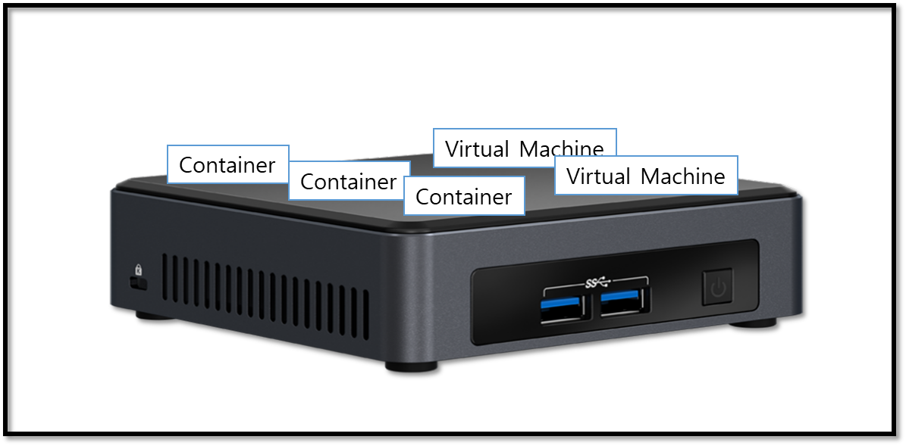
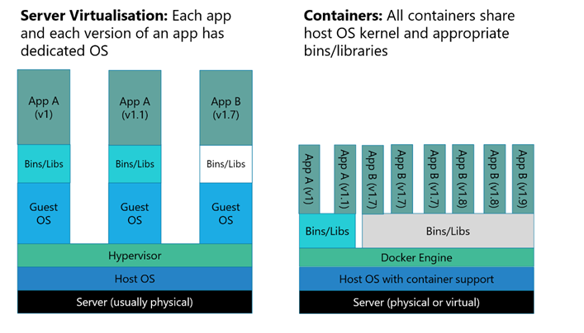

VMs and Containers on a Linux Box
On a Linux Box (e.g., NUC)
Multiple fully-isolated (with dedicated resources), but heavy VM instances (i.e., VMs).
Multiple partially-isolated, lightweight container instances (i.e., containers)
Virtual Machines (VMs)
Containers
Heavier than
Container!
Hypervisor Tool for creating VMs
Container Runtime Tool for running containers

Slide 8

A Switch inside Linux Box: Open vSwitch
VM
Container
Tap1
ping test
br0
eno1

Slide 9
Virtual Switch in a Box to connect VMs
Hypervisor
VM
VM
VM
VM
Linux Box
Virtual NIC
Virtual interface
Virtual switch
Virtual L2 network
Physical switch
L2 network
A software-based virtual switch allows one VM to communicate with neighbor VMs as well as to connect to Internet (via physical switch).
Software-based switches (running with the power of CPUs) are known to be more flexible/upgradable and benefited of virtualization (memory overcommit, page sharing, …)
VMs (similarly containers) have logical (virtual) NIC with virtual Ethernet ports so that they can be plugged into the virtual interface (port) of virtual switches.

Slide 10

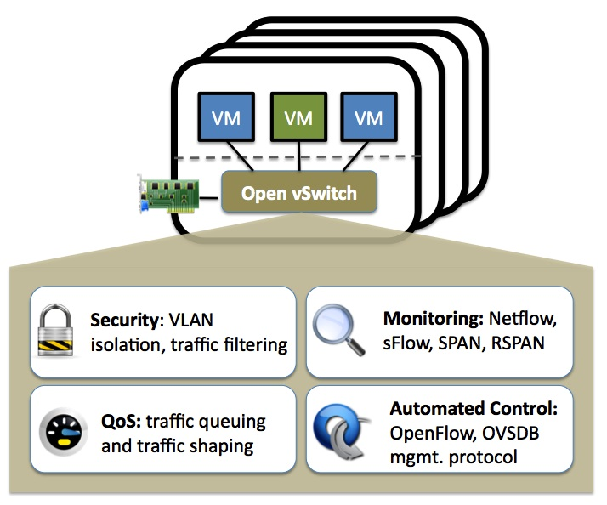
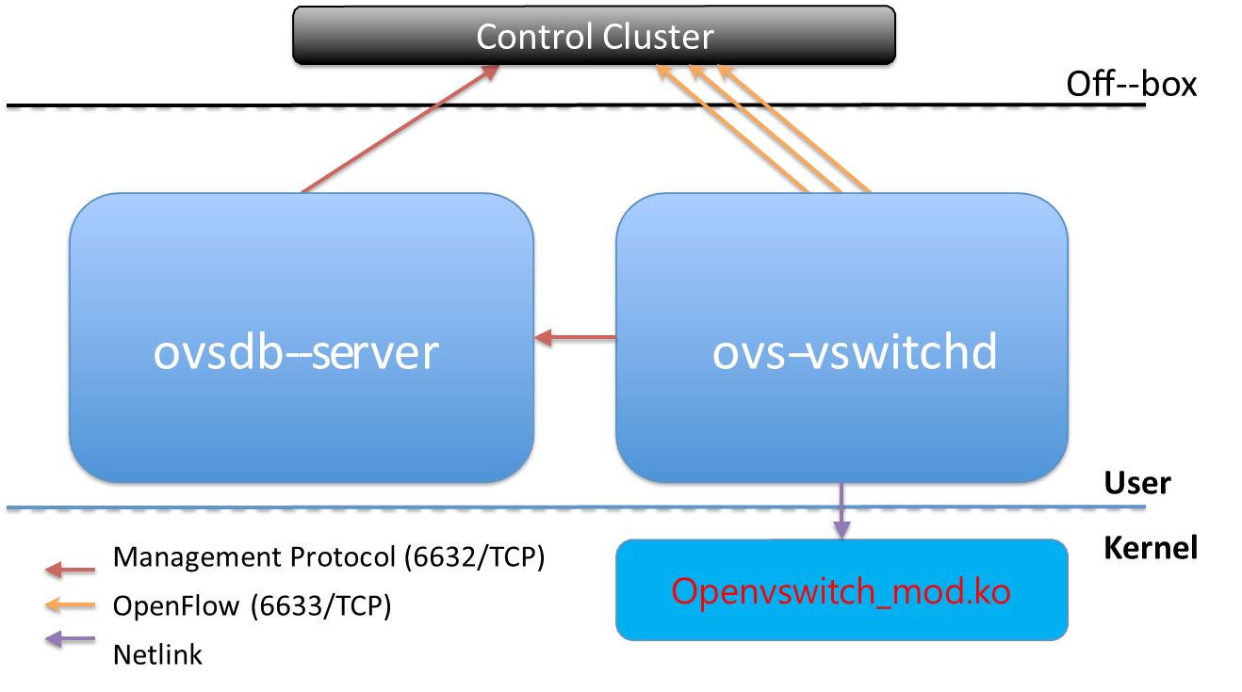
Linux-adopted virtual switch: Open vSwitch
http://openvswitch.org/
Open vSwitch is an open-source virtual switch software designed for virtual servers.
OVS Main components

Slide 11
Lab Practice

Slide 12
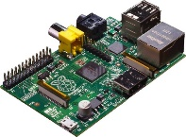
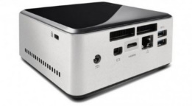


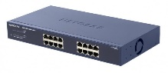
NAME: NUC5i5MYHE (NUC PC) CPU: Intel® Core™ i3-8109U 3.60 GHz CORE: 2 Memory: 32GB DDR4 HDD: 94GB
#0 - Lab Preparation
Wired connection
NAME: Raspberry Pi Model B (Pi) CPU: ARM Cortex A7 @900MHz CORE: 4 Memory: 1GB SD Card: 32GB
NAME: NT900X3A
CPU: i5-2537U @1.40GHz
CORE: 2 Memory: 4GB DDR3 HDD: 128GB
NAME: netgear prosafe 16 port gigabit switch(Switch) Network Ports: 16 auto-sensing 10/100/1000 Mbps Ethernet ports

Slide 13

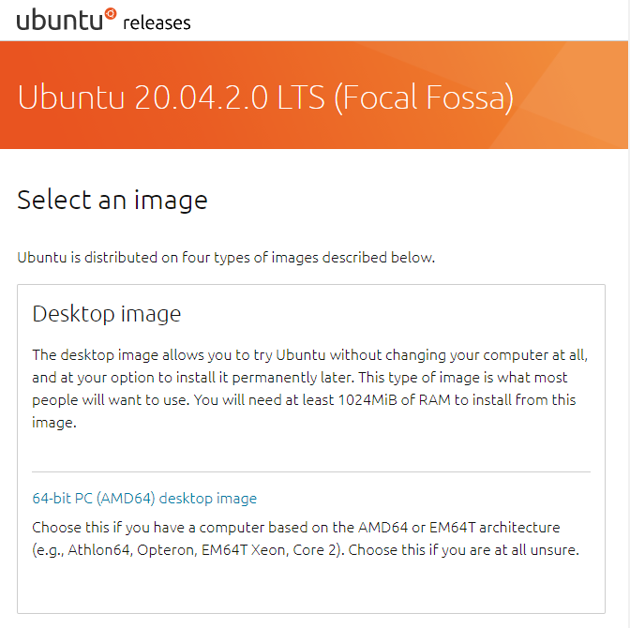
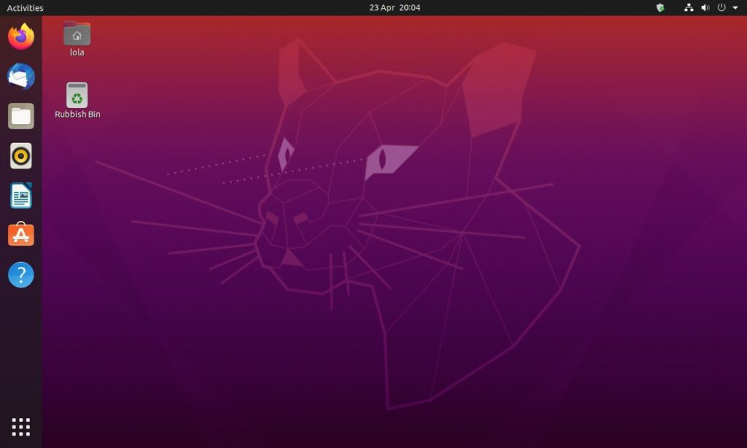
#1 - NUC: OS Installation
OS : Ubuntu Desktop 20.04 LTS(64bit)
Download Site : https://releases.ubuntu.com/20.04/
Installed on NUC
Ubuntu Home Screen After Installation

Slide 14
#1 - NUC: OS Installation
- OS Installation
Updates and other software
Select ‘Minimal installation’
Installation type
Select ‘Something else’
On /dev/sda or /dev/nvme0n1
(UEFI), add 512MB EFI partition
Add empty partition with 20GB (20480MB) (Select ‘do not use the partition’)
Add Etc4 partition on leave memory
Select Boot loader
BIOS: Ext4 partition
UEFI: EFI partition
LVM관련 오류 발생 시
뒤로 이동하여 Installation type화면으로 이동
Erase disk 선택
시간대 선택화면까지 진행
다시 뒤로 돌아가서 다시 Installation type화면으로 이동
Something else선택 후 정상 진행

Slide 15
#2 - NUC: Network Configuration
VM
Container
Tap1
ping test
br0
eno1

Slide 16
#2 - NUC: Network Configuration
- ‘Temporary’ Network Configuration using GUI
VM
Container
Tap1
ping test
br0
eno1

Slide 17
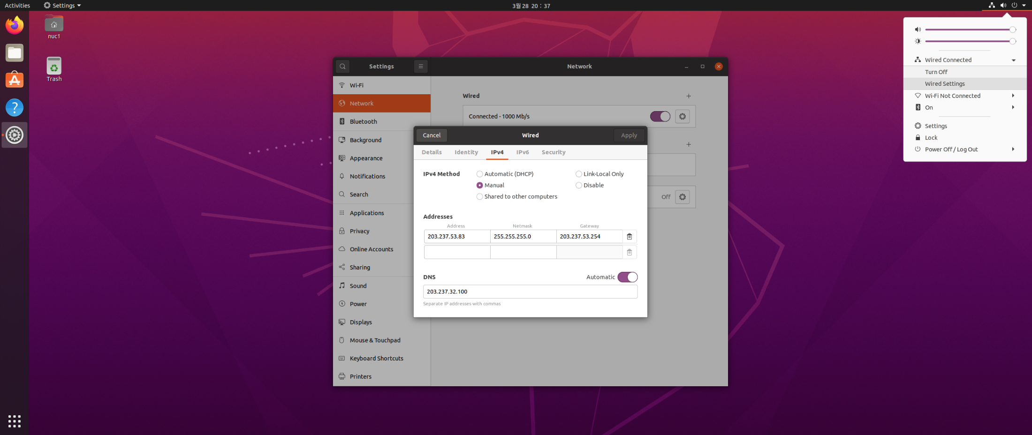
#2 - NUC: Network Configuration
- ‘Temporary’ Network Configuration using GUI
Click the LAN configuration icon.
Enter the network info.
(IP address, subnet mask, gateway)

Slide 18
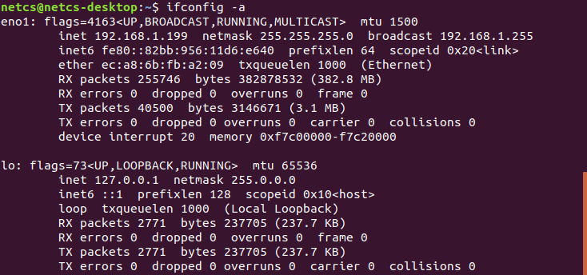
#2 - NUC: Network Configuration
- Set Prerequisites
0. Update & Upgrade
$sudo apt update
$sudo apt upgrade
1. Install net-tools & ifupdown
$sudo apt install net-tools ifupdown
$ifconfig -a

Slide 19
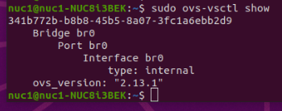
#2 - NUC: Network Configuration
- Set Prerequisites
2. Install openvswitch-switch & make br0 bridge
$sudo apt intall openvswitch-switch
$sudo ovs-vsctl add-br br0
$sudo ovs-vsctl show
ovs-vsctl show

Slide 20
#2 - NUC: Network Configuration
- Network interface
VM
Container
Tap1
ping test
br0
eno1

Slide 21
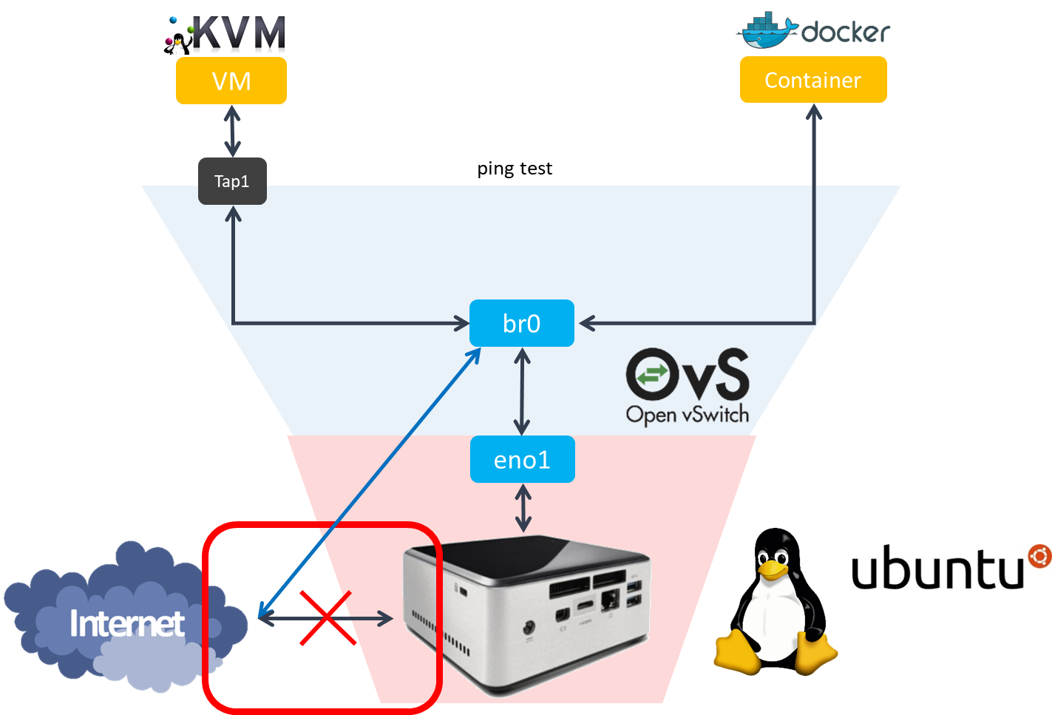
#2 - NUC: Network Configuration
- Network interface
Disable netplan
$sudo su
#systemctl stop systemd-networkd.socket systemd-networkd networkd-dispatcher \
systemd-networkd-wait-online
#systemctl disable systemd-networkd.socket systemd-networkd networkd-dispatcher \
systemd-networkd-wait-online
#systemctl mask systemd-networkd.socket systemd-networkd networkd-dispatcher \
systemd-networkd-wait-online
#apt-get --assume-yes purge nplan netplan.io
#exit

Slide 22
#2 - NUC: Network Configuration (1/3)
- eno1 interface
$sudo vi /etc/systemd/resolved.conf
----------------- /etc/systemd/resolved.conf -----------------
…
DNS = 8.8.8.8 8.8.4.4
…
----------------------------------------------------------------------------
$sudo systemctl restart systemd-resolved.service
$sudo ifup eno1
Your Box
NUC internet works!
eno1
<Your IP addr>

Slide 23
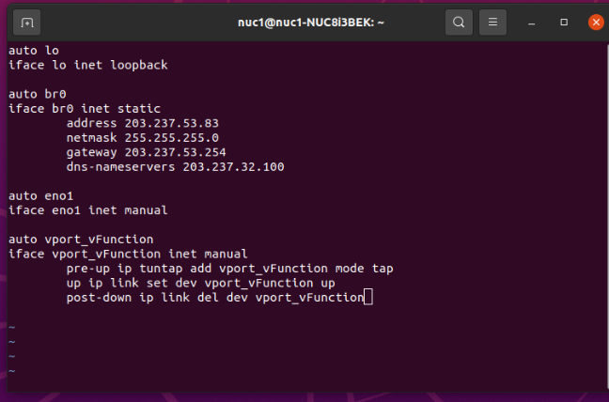
#2 - NUC: Network Configuration
- Network interface
Open /etc/network/interfaces via 'vi'
$sudo vi /etc/network/interfaces
Configurate the Network Interface vport_vFunction is a tap interface and attach it to your VM.
----------------- /etc/network/interfaces -----------------
auto lo
iface lo inet loopback
auto br0
iface br0 inet static
address <your nuc ip>
netmask 255.255.255.0
gateway <gateway ip>
dns-nameservers 8.8.8.8
auto eno1
iface eno1 inet manual
auto vport_vFunction
iface vport_vFunction inet manual
pre-up ip tuntap add vport_vFunction mode tap
up ip link set dev vport_vFunction up
post-down ip link del dev vport_vFunction
----------------------------------------------------------------------------
Some NUC have different Interface name.
So you need to check your NUC’s interface name using
‘ip a’ command.

Slide 24
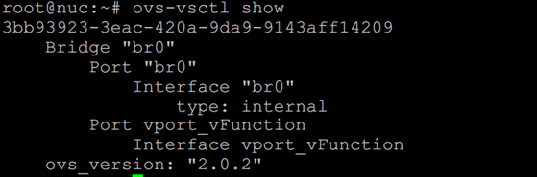
#2 - NUC: Network Configuration
- Network interface
We will make VM attaching vport_vFunction. You can think this tap as a NIC of VM.
Below is the figure you configurated so far
Your Box
VM
---your vm ip---
vport_vFunction
br0
---your nuc ip---
[tap_name]
eno1
---your nuc ip---

Slide 25
#2 - NUC: Network Configuration
- Network interface
Restrart the whole interfaces 1
$sudo su
#systemctl unmask networking
#systemctl enable networking
#systemctl restart networking
add port ‘eno1’ and ‘vport_vFunction’ to ‘br0’
$sudo ovs-vsctl add-port br0 eno1
$sudo ovs-vsctl add-port br0 vport_vFunction
$sudo ovs-vsctl show
Restrart the whole interfaces 2
#systemctl unmask networking
#systemctl enable networking
#systemctl restart networking
#exit

Slide 26
KVM-based VM connected via OVS
- Goal of this section
VM

Slide 27
#3 - NUC: Making VM with KVM
VM
Container
[Tap_name]
vport_vFunction
Tap0
ping test
br0
eno1

Slide 28
#3 - NUC: Making VM with KVM
-Install dependency to upgrade KVM
Install dependency & download Ubuntu 20.04 64bit server image.
$sudo apt install qemu-kvm libvirt-daemon-system libvirt-clients bridge-utils
//upgrade KVM
//qemu is open-source emulator
$wget http://old-releases.ubuntu.com/releases/focal/ubuntu-20.04-beta-live-server-amd64.iso
Now we are ready to make VM. So, continue the setting.

Slide 29
#3 - NUC: Making VM with KVM
-Prepare for Ubuntu VM
Make a VM image.
$sudo qemu-img create [img_name].img -f qcow2 [storage_capacity]
$sudo qemu-img create vFunction20.img -f qcow2 10G
Boot VM image from Ubuntu iso file (띄어쓰기 주의!).
$sudo kvm -m [memory_capacity] -name [vm_name] \
-smp cpus=[#cpu],maxcpus= [#maxcpu] \
-device virtio-net-pci,netdev=net0 \
-netdev tap,id=net0,ifname= [tap_name],script=no \
-boot d [img_name].img \
-cdrom ubuntu-20.04-beta-live-server-amd64.iso -vnc :[#] \
-daemonize -monitor telnet:127.0.0.1:3010,server,nowait,ipv4
$ sudo kvm -m 1024 -name tt -smp cpus=2,maxcpus=2 -device virtio-net-pci,netdev=net0 -netdev tap,id=net0,ifname=vport_vFunction,script=no -boot d vFunction20.img -cdrom ubuntu-20.04-beta-live-server-amd64.iso -vnc :5 -daemonize -monitor telnet:127.0.0.1:3010,server,nowait,ipv4

Slide 30
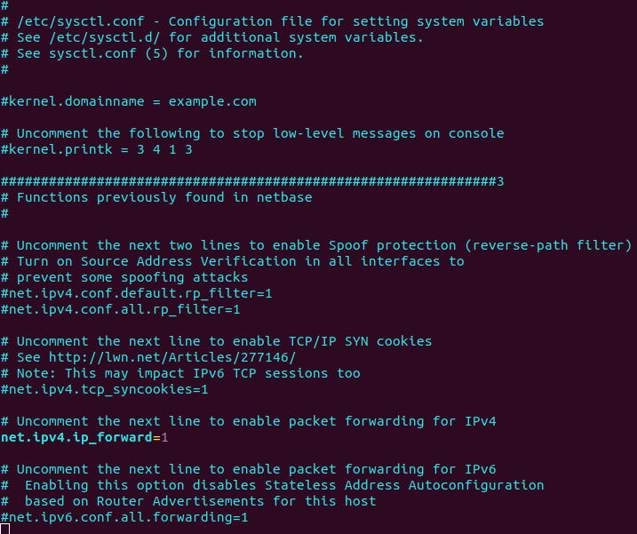
#3 - NUC: Making VM with KVM
-Prepare for Ubuntu VM
Configure SNAT with iptables for VM network
$sudo iptables –A FORWARD –i eno1 –j ACCEPT
$sudo iptables –A FORWARD –o eno1 –j ACCEPT
$sudo iptables –t nat –A POSTROUTING –s 192.168.100.0/24 –o eno1 –j SNAT --to <Your ip address>
$vi /etc/sysctl.conf
#net.ipv4.ip_forward=1
net.ipv4.ip_forward=1
$sysctl –p
net.ipv4.ip_forward = 1
Configuration complete

Slide 31
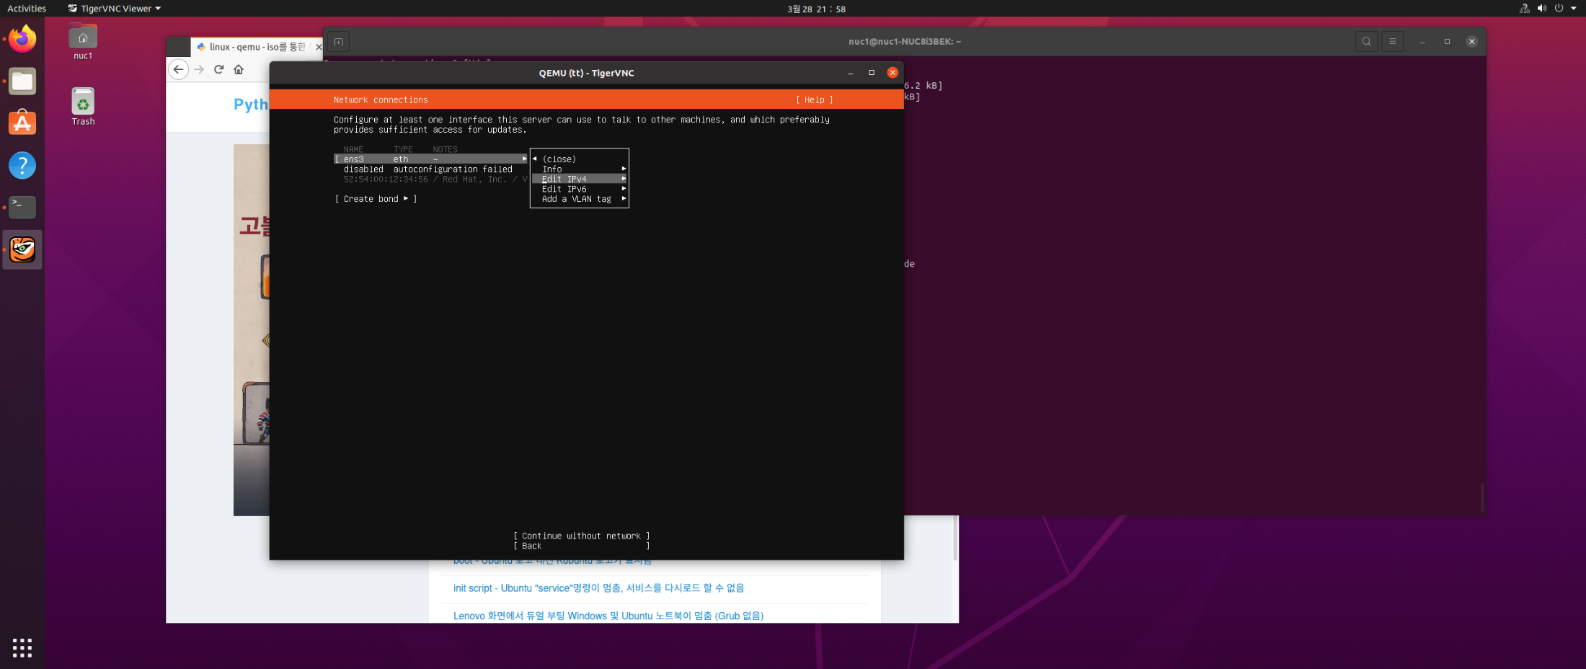
#3 - NUC: Making VM with KVM
-Install Ubuntu VM (control with ‘Enter key’ and ‘Arrow keys’)
Install VNC viewer and see inside of VM
$sudo apt-get install tigervnc-viewer
$vncviewer localhost:5
If ok, you can see window like this

Slide 32
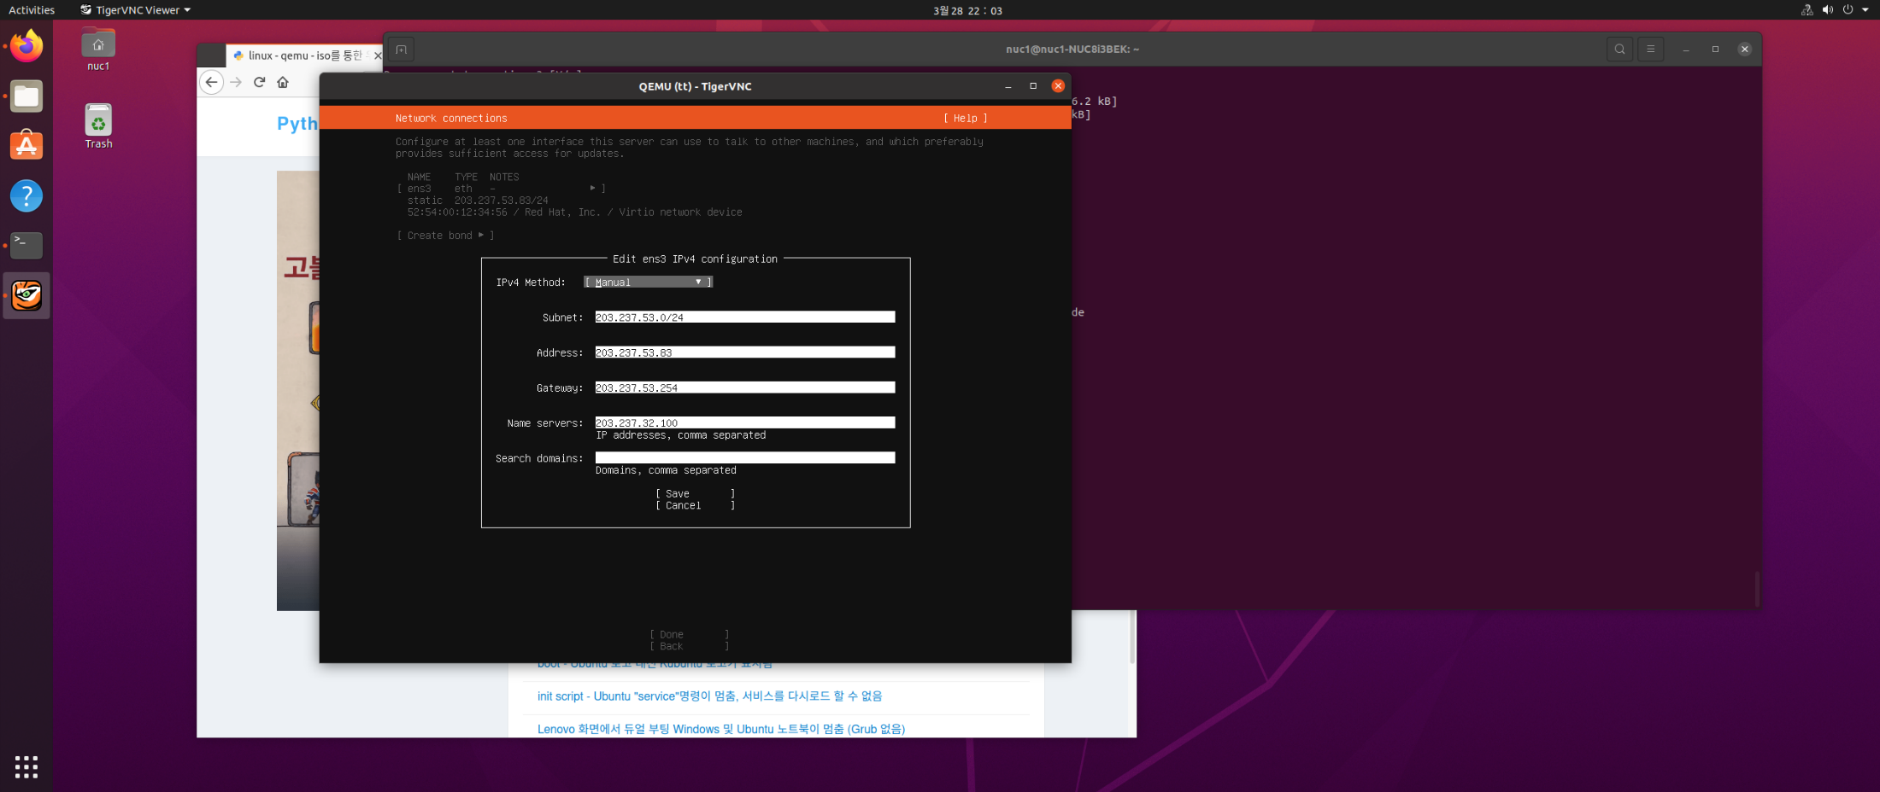
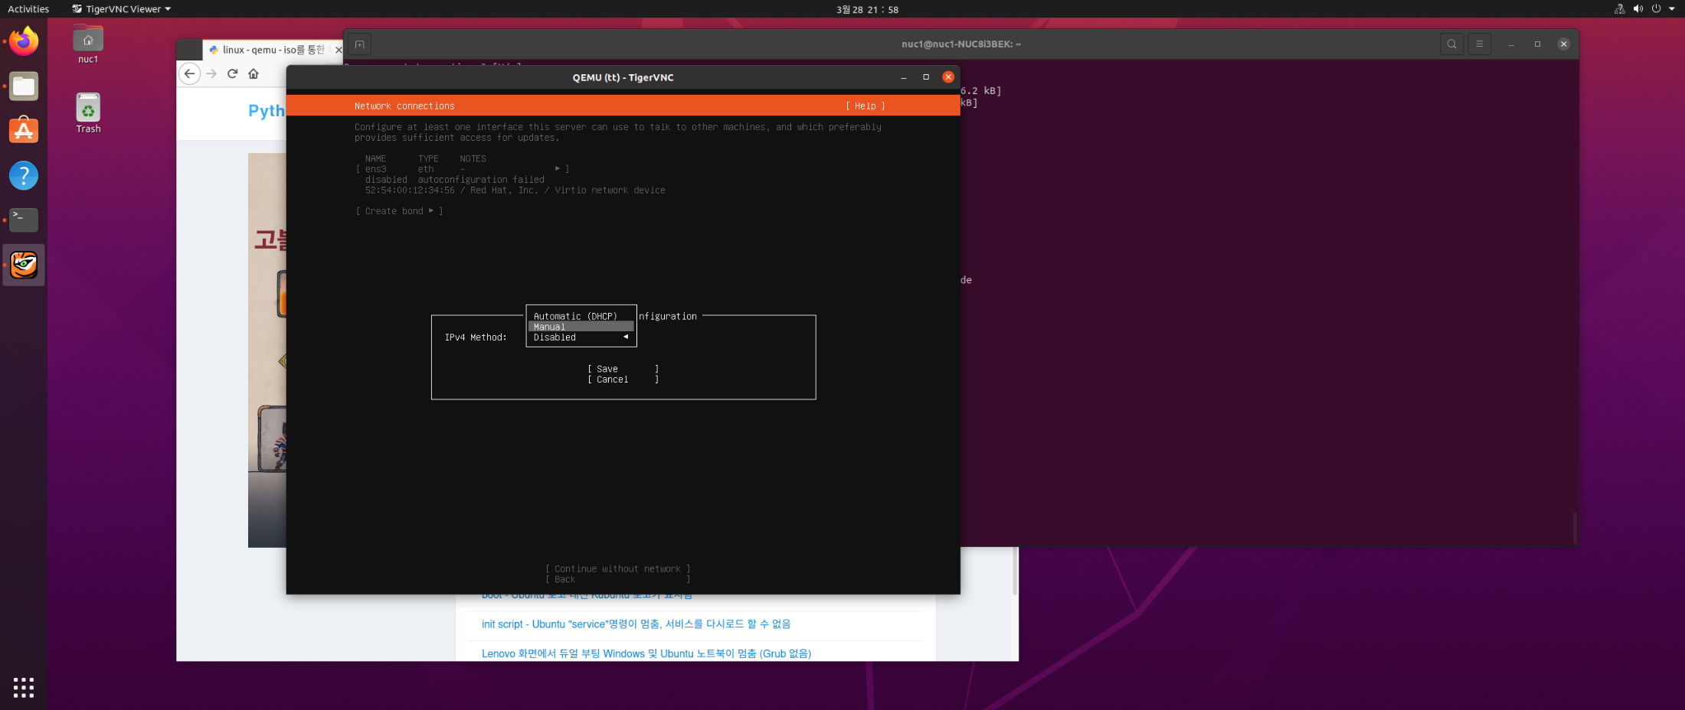
#3 - NUC: Making VM with KVM
- VM network configuration (control with ‘Enter key’ and ‘Arrow keys’)
네트워크 디바이스 선택 -> Edit IPv4
IPv4 Method -> Manual
설정
subnet: 203.237.53.0/24
Address: <your vm ip>
Gateway: <gateway ip>
Name Servers: 8.8.8.8
1. Select network device ‘Edit IPv4’
3. Enter the network info.
2. Select ‘Manual’

Slide 33
#3 - NUC: Making VM with KVM
- Installation Completed (control with ‘Enter key’ and ‘Arrow keys’)
When ‘installation completed’ message is shown, terminate the VM
$ sudo killall -9 qemu-system-x86_64
boot VM again (mac should be different from others).
$sudo kvm -m [memory_capacity] -name [vm_name] \
-smp cpus=[#cpu],maxcpus= [#maxcpu] \
-device virtio-net-pci,netdev=net0 \
-netdev tap,id=net0,ifname= [tap_name],script=no \
-boot d [img_name].img \
-daemonize
$ sudo kvm -m 1024 -name tt -smp cpus=2,maxcpus=2 -device virtio-net-pci,netdev=net0 -netdev tap,id=net0,ifname=vport_vFunction,script=no -boot d vFunction20.img -vnc :5 -daemonize

Slide 34
#5 - OVS connects with KVM
- Check situation
VM
ip : ---your vm ip---
tap_name
br0
ip : ---your nuc ip---
eno1
ip : ---your nuc ip---

Slide 35
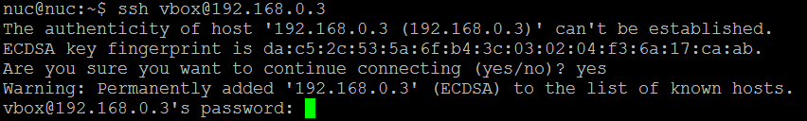
#6 - NUC: Installing ssh in VM
- Don’t forget to install ssh in VM
In VMs,
$sudo apt update
$sudo apt -y install net-tools ssh

Slide 36
Docker Container connected via OVS
- Goal of this section

Slide 37
#7 - Making a Docker Container
VM
Container
Tap0
ping test
br0
eno1

Slide 38
#7 - Making a Docker Container
- Docker installation
In NUC, Docker installation.(Based on Docker Documentation link)
// Set up the repository:
// Install packages to allow apt to use a repository over HTTPS
$ sudo apt-get update
$ sudo apt-get install -y ca-certificates curl gnupg lsb-release
// Add Docker's official GPG key:
$ curl -fsSL https://download.docker.com/linux/ubuntu/gpg | sudo gpg --dearmor -o /usr/share/keyrings/docker-archive-keyring.gpg
// Add the Docker apt repository:
$ echo \
"deb [arch=$(dpkg --print-architecture) signed-by=/usr/share/keyrings/docker-archive-keyring.gpg] https://download.docker.com/linux/ubuntu \
$(lsb_release -cs) stable" | sudo tee /etc/apt/sources.list.d/docker.list > /dev/null
// Install Docker CE
$ sudo apt-get update
$ sudo apt-get install docker-ce docker-ce-cli containerd.io
// Create /etc/docker
$ sudo mkdir -p /etc/docker
cont‘d on next page

Slide 39
#7 - Making a Docker Container
- Docker installation
In NUC,
Docker installation (cont’d)
//continued
// Set up the Docker daemon
$ cat <<EOF | sudo tee /etc/docker/daemon.json
{
"exec-opts": ["native.cgroupdriver=systemd"],
"log-driver": "json-file",
"log-opts": {
"max-size": "100m"
},
"storage-driver": "overlay2"
}
EOF
// Create /etc/systemd/system/docker.service.d
$ sudo mkdir -p /etc/systemd/system/docker.service.d
$ sudo systemctl daemon-reload
$ sudo systemctl enable docker
$ sudo systemctl restart docker
$ sudo systemctl restart docker.socket

Slide 40
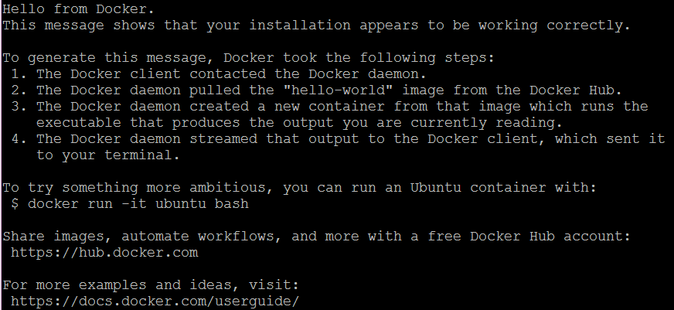
#7 - Making a Docker Container
- Docker installation
In NUC,
Now Installation completed. Let's Check it
$ sudo docker run hello-world
reference: http://docs.docker.com/linux/step_one/

Slide 41
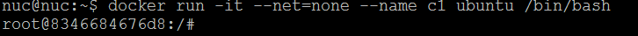
#7 - Making a Docker Container
- Make container
Run docker container. (**Remember the container_name)
$sudo docker run -it --net=none --name [container_name] ubuntu /bin/bash
※ctrl + p, q → detach docker container
※docker attach [container_name] → get into docker container console

Slide 42
#8 - Connect Docker Container
- Connect with OVS bridge
VM
Container
Tap0
ping test
br0
eno1

Slide 43
#8 - Connect docker Container
- Connect with OVS bridge
Install OVS-docker utility in host machine. (Not in inside of Docker container.)
$sudo ovs-docker add-port br0 veno1 [container_name] --ipaddress=---your docker ip---/24 \
--gateway=---gateway ip---
$sudo docker attach [container_name] //enter to docker container
#apt update
#apt install net-tools
#apt install iputils-ping

Slide 44
#9 – Keep Docker network configuration
- /etc/rc.local
Modify /etc/rc.local
$sudo vi /etc/rc.local
#!/bin/bash
docker start [container_name]
ovs-docker del-port br0 veno1 [containerName]
ovs-docker add-port br0 veno1 [container_name] --ipaddress=---your docker ip---/24 --gateway=---gateway ip---
Whenever NUC is rebooted,
network configuration of Docker container is initialized
by executing commands in rc.local

Slide 45
#10 – Check connectivity: VM & Container
VM
Container
Tap0
ping test
br0
eno1

Slide 46


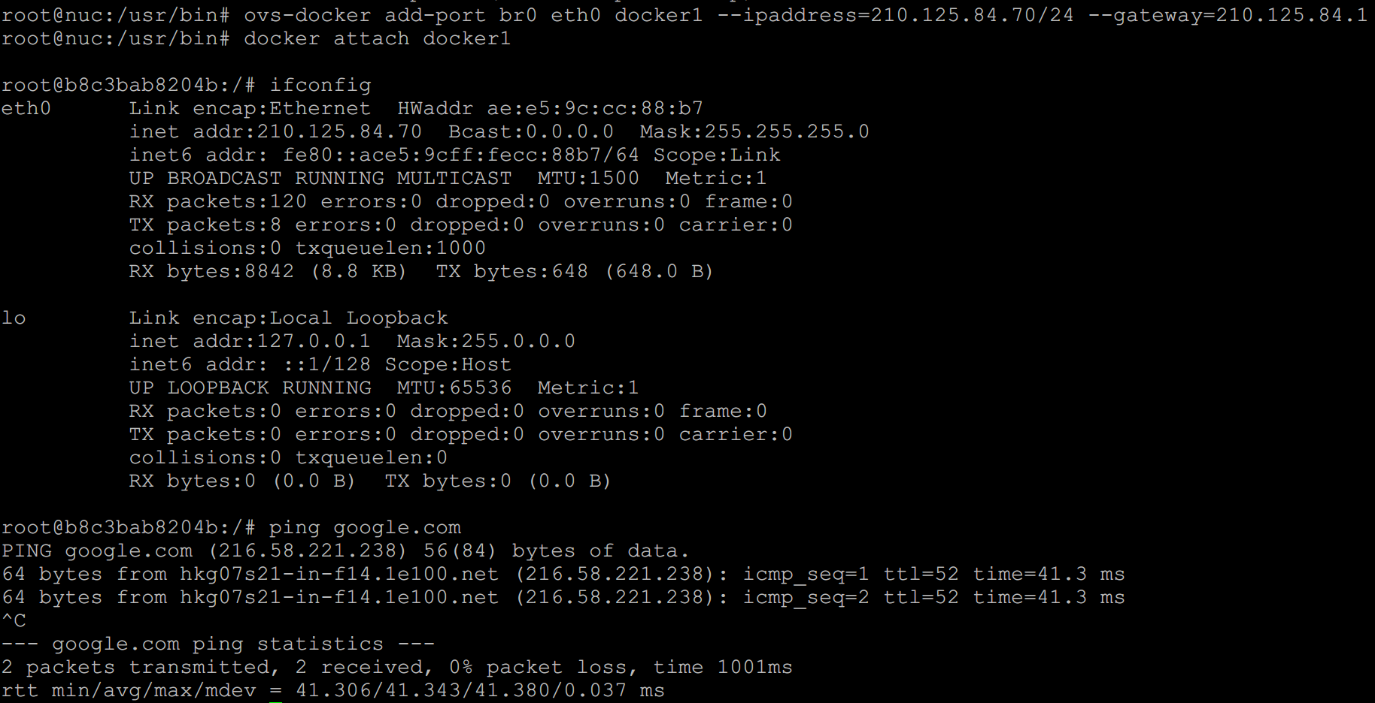
#10 - Check connectivity: VM & Container
-Check connectivity with ping command

Slide 47
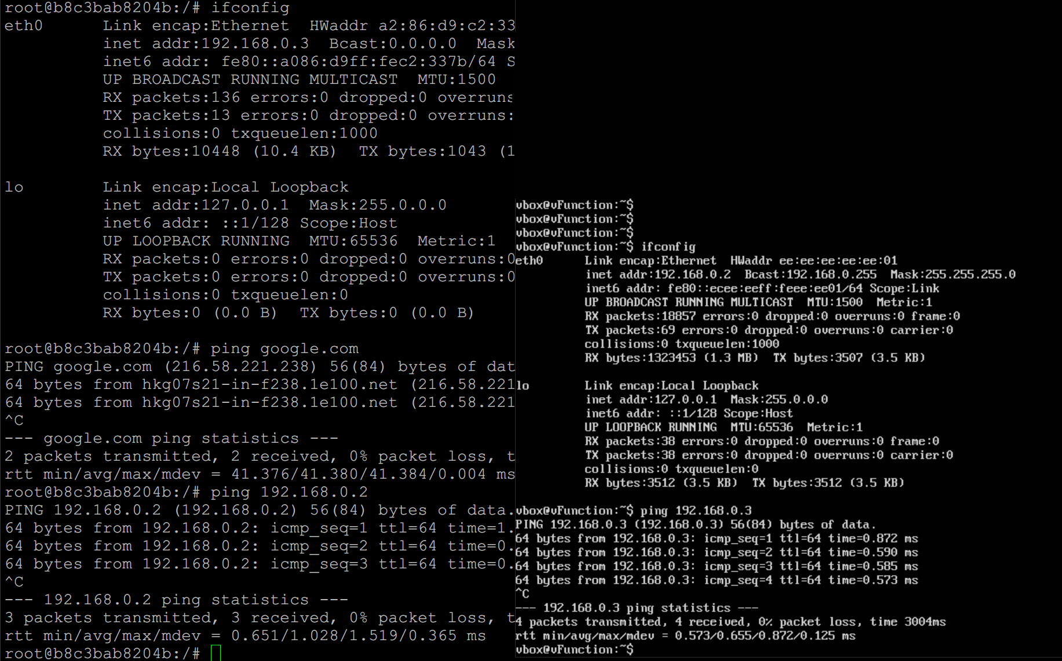
#10 - Check connectivity: VM & Container
-Check connectivity with ping command
Docker container
KVM VM

Slide 48
Box Lab: Final Goal (Recap)
VM

Slide 49
Lab Review

Slide 50
Lab Summary
With Box Lab, you have experimented
How to install and configure Linux OS into Box (i.e., computer).
How to install and configure OVS (Open vSwitch) virtual switch inside a Linux Box and configure it.
How to create VMs and Docker containers inside a Linux Box and then inter-connect each of them together and to the Internet.

Slide 51
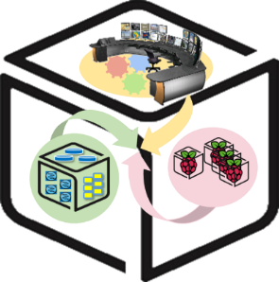
Thank You for Your Attention
Any Questions?
mini@smartx.kr

